Slide 1
Lightning Migration Dirty Secrets
Michael Farrington
@michaelforce

Slide 2
Michael Farrington
14 years of experience on the platform
Salesforce MVP Hall of Fame Member
~20-time Dreamforce Speaker
Snowforce 2014 Keynote Speaker
Former Las Vegas User Group Leader
1% of all AppExchange Installs are apps I personally designed and developed

Slide 3
Agenda
Stroke my ego
The Path Forward… and a Foreword
Things they tell you about
Things they tell you about, but exclude key details
Things they *don’t* tell you about

Slide 4
The Path Forward

Slide 5
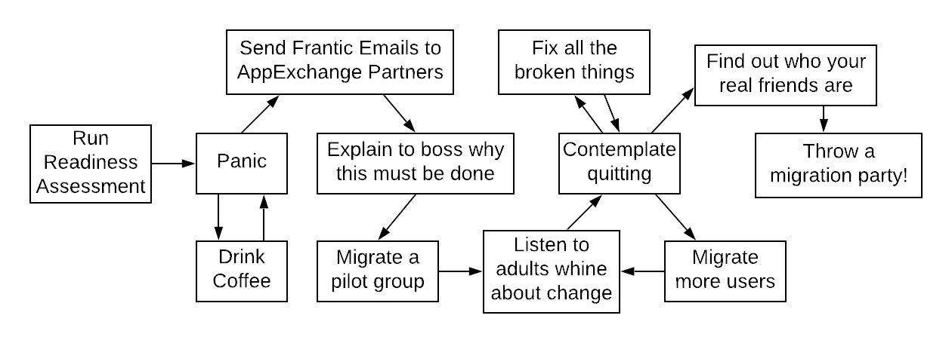
The Real Path Forward

Slide 6
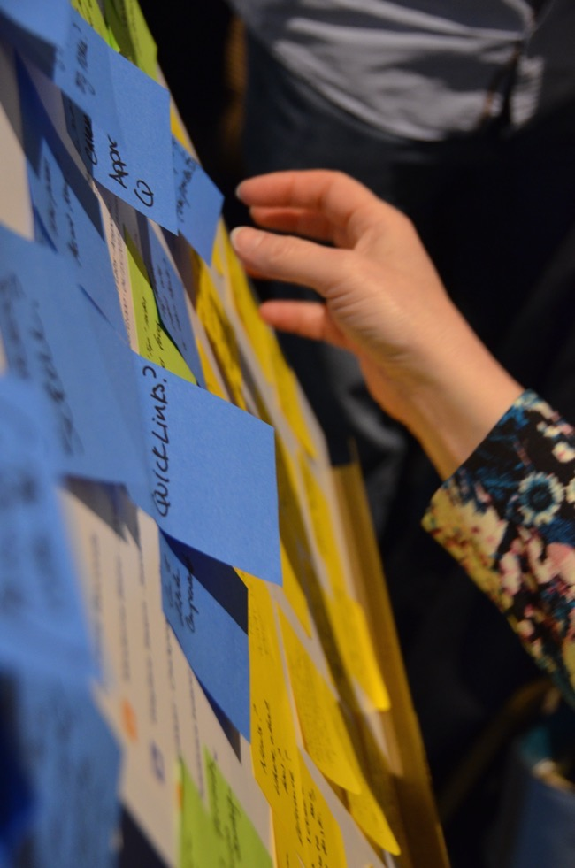
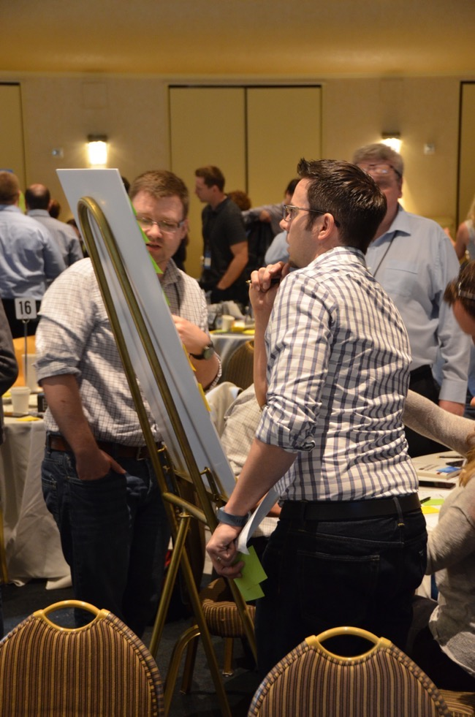
Foreword
photos courtesy of shellblack.com
Notes:
Disclaimer: I love Salesforce and I think they’ve done a great job with LEX. If you’re fairly new to Salesforce you might not know that LEX solves a ton of problems that people have been complaining about for years. There was an MVP summit just before LEX became a thing; the amount of Product Management and thoughtful gathering of feedback and requirements in that session alone was astounding. I really feel like they hit the mark is far more ways than not, and deserve credit for that.

Slide 7
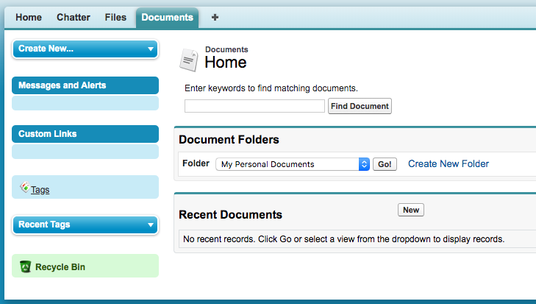
Things they tell you about
Notes:
Recycle Bin – making a return in Winter 20! Until then there is actually an AppExchange app, and some other workaround you can find here: https://saturn.salesforce.com/answers?id=9063A000000pLQ6QAM
Documents Tab – docs will still exist, but Tab only accessible in Classic
Whole Sidebar – not part of the Lightning paradigm

Slide 8
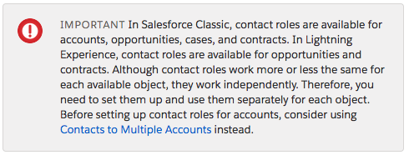
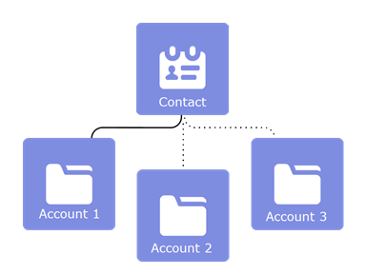
Things they tell you about
Notes:
Contact Roles on Accounts are no longer a thing.

Slide 9
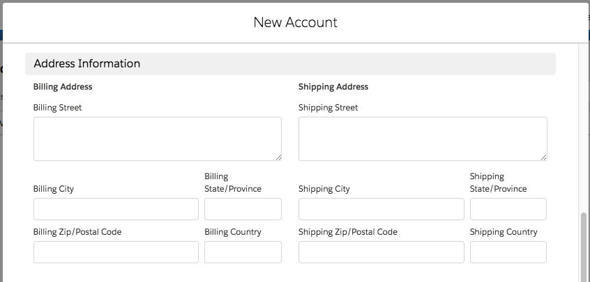
Things they tell you about

Slide 10
Things they tell you about
Notes:
No “sharing” button – Help files say “This is on the roadmap for a future release coming soon.”
Here is the idea: https://success.salesforce.com/ideaView?id=0873A000000LmluQAC
Here is an AppExchange app: https://appexchange.salesforce.com/appxlistingdetail?listingId=a0N3A00000EFp0ZUAT

Slide 11
Things they tell you about
Notes:
I’m not really sure what this is all about… I guess so few customers use this feature they are just dropping it??

Slide 12
Things they tell you about, but exclude key details
You can use Magic Mover to migrate Notes and Attachments
Orgs have a limit of documents and versions that can be modified in a 24-hour period. For most orgs, this is 200,000. Support can temporarily suspend this limit.
If you hit heap or CPU timeout errors lower your batch size
Notes:
Magic Mover: https://appexchange.salesforce.com/appxListingDetail?listingId=a0N3A00000EHAmyUAH

Slide 13
Things they tell you about, but exclude key details
Visualforce will “just work”… but don’t use “window” and test Custom JavaScript and iFrames
Need to use sforce.one navigation in a dynamic fashion after detecting LEX versus classic
Need to consider more than just the “Visualforce Report”, Apex Controllers / Extensions might return invalid PageReferences such as link to edit record
Notes:
Help file with example of checking for LEX before using sforce.one:
https://help.salesforce.com/articleView?id=lex_prepare_vf_window.htm&type=5

Slide 14
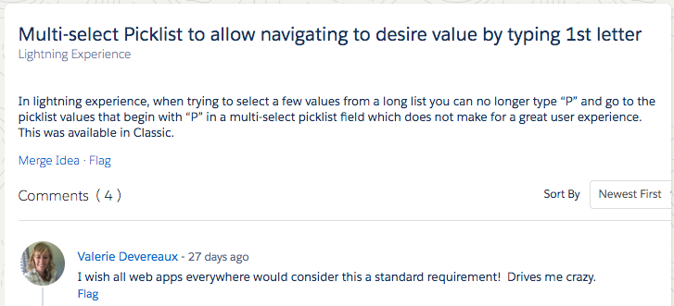
Things they *don’t* tell you about

Slide 15
Things they *don’t* tell you about
Do your users tend to send links to each other?
Melanie Zilles Head
@MelSFDC
Notes:
Keep in mind: users who are on lightning may send links to records and such to users not yet on lightning… if they do they get this error.

Slide 16
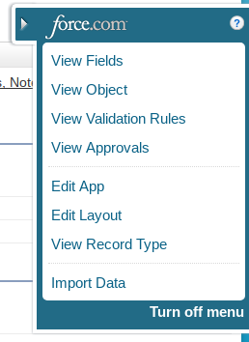
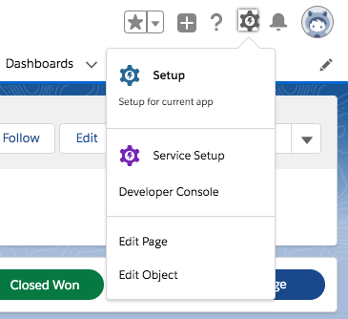
Things they *don’t* tell you about
Notes:
No more “Quick Access Menu”… next best thing is to check the settings menu on certain pages.

Slide 17
Things they *don’t* tell you about
If you have a user on Safari 12+, and they are getting persistent prompts or unwanted new tabs when trying to use links in LEX… Have them clear their cookies.

Slide 18
Things they *don’t* tell you about
Notes:
Help file on this: https://help.salesforce.com/articleView?id=000318421&type=1&mode=1

Slide 19
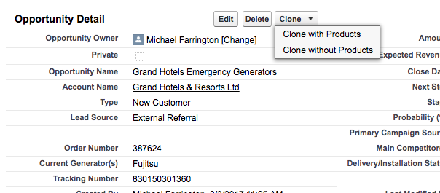
Things they *don’t* tell you about
Nick Lindberg
@NickersUniverse
Notes:
No standard “Clone with Products” function in Lightning, but check out the idea. The top comment includes a link to a package that can help:
https://success.salesforce.com/ideaView?id=0873A000000cMbMQAU

Slide 20
Things they *don’t* tell you about
Notes:
Link to idea: https://success.salesforce.com/ideaView?id=08730000000cHYhAAM

Slide 21
Questions?

Slide 22
Thank You!

